Slide 1

vCommunity & vSphere upgrade/migration from 6.0 u2 to 6.5 u1e and VCSA Migration
By @erickubla
V3

Slide 2
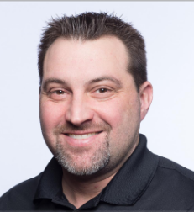
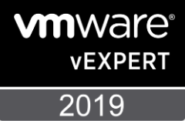


About the presenter! @erickubla
IT Server Manager @ First Commonwealth Bank
Western & Central PA, Canton, Columbus, Cincinnati OH
5+ years as a Pittsburgh VMUG @pghvmug leader (formerly Western PA)
4 years as a vExpert

Slide 3
You can find this ppt in https://github.com/ekubla/Presentations and your local VMUG forum
@erickubla
kubla731@yahoo.com

Slide 4
A favor
Take a pic during this session. Tweet it out with #VMUG, #vCommunity, #MileHighVMUG, #DenverVMUG, #5280, @erickubla, @DenverVMUG, and @MyVMUG.
I enjoy interacting with people on Twitter and the #vCommunity – send me any questions you think of!

Slide 5
Agenda
vCommunity
vSphere upgrade to 6.5/VCSA Migration
Tips and resources
Q&A

Slide 6
What is vCommunity
Any social media interaction with others in tech
Meeting up with locals, vBeers
Attending VMUGs and other tech events
Interact & engage
Little Hacks

Slide 7
vCommunity
How did I get here today?
VMUG Leader 5+ years
vBrisket - @vbrisket
vExpert - @vExpert
PGHLittleHack - @carlcapozza (possible BigHack @ UserCon 5/23)
Blair County Little hack (@cpavmug @adminwillie)
@vbrownbag – Community members present
Slack
@erickubla

Slide 8
vCommunity – How did I get here today?
What’s involved with being a VMUG leader?
Helping others
Being involved in a larger IT community & meeting new people
Break out of your comfort zone/Trying new things
HELP! – Ask for it.

Slide 9
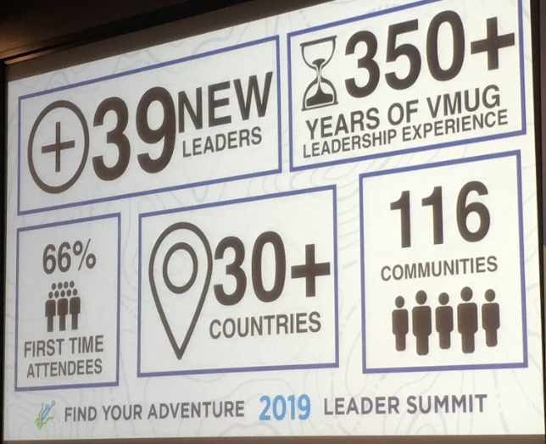

Slide 10
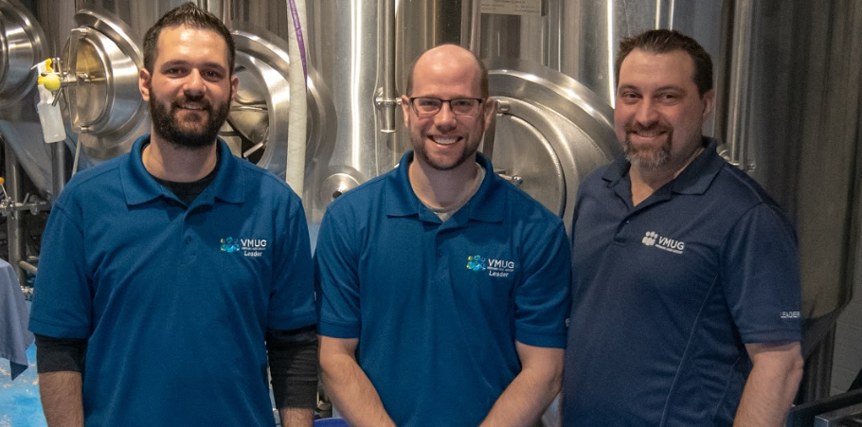
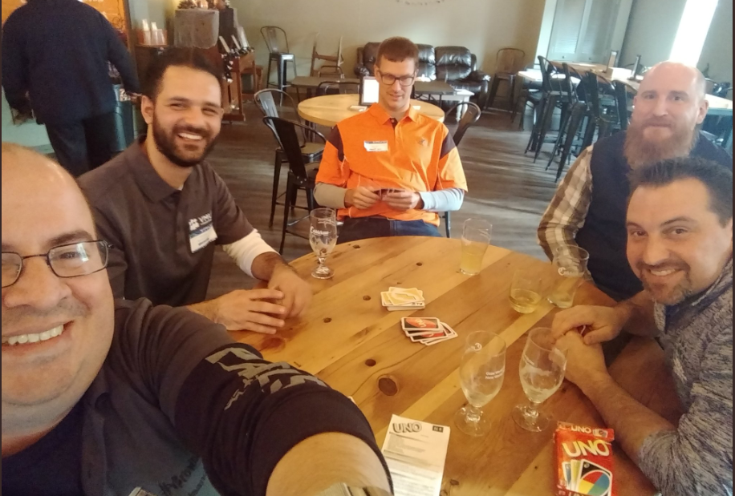
VMUG - @PGHVMUG
@erickubla
@khoury1701 – @PGHVMUG Leader
@dougdefrank – new @PGHVMUG Leader
2019 - 5 regular events, UserCon, EoY Party
@arielsanchezmor – VMWare TAM @puthoffmatt – VMWare TAM
@gsxesx – @CPAVMUG Leader & VMUG East Regional Champion

Slide 11
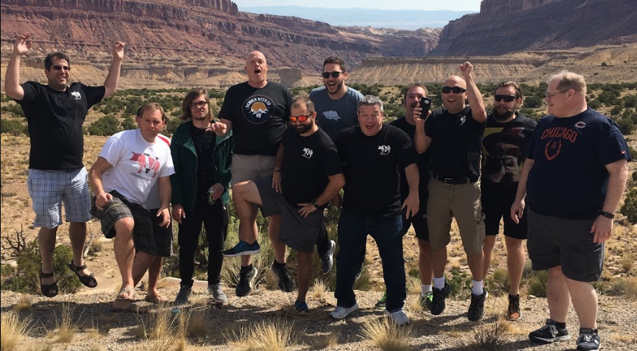
vCommunity - @vbrisket
Chicago to Vegas VMWorld 2016 bus trip
Sponsored by multiple vendors
Meat up with Chicago VMUG, Kansas City VMUG, and Denver VMUG
Had a Meat up in San Fran @ VMWorld 2015

Slide 12
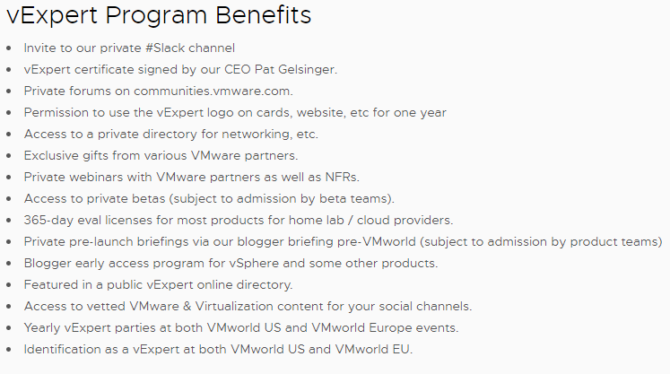

vCommunity - @vExpert
Share knowledge, engage with community
Benefits
Blogging
Speaking
VMUG Leader
Forums

Slide 13
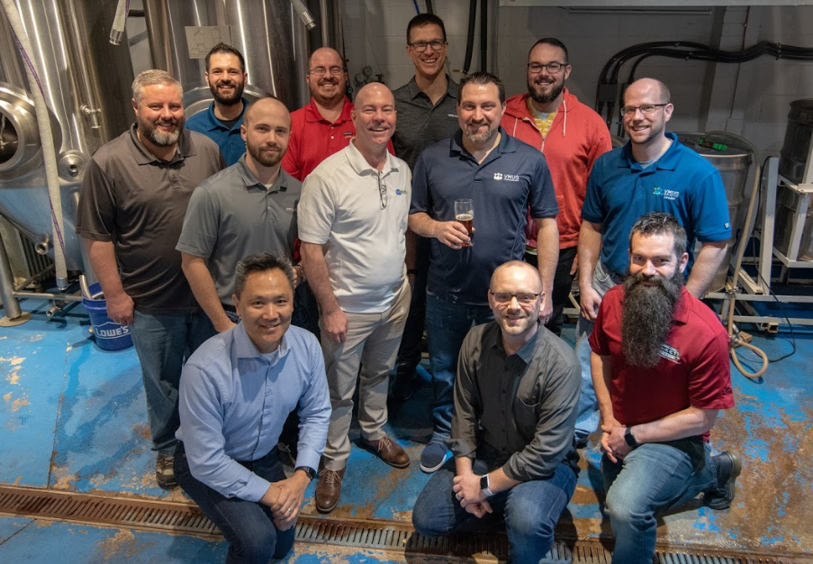
vCommunity - @vExpert

Slide 14
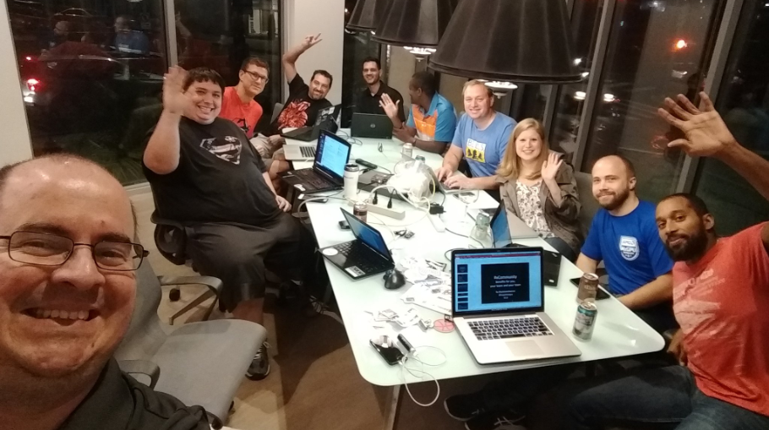
vCommunity – PGHLittleHack
Started by @carlcapozza
Try to meet once a month
Open forum, no set plan, just collaborate and network
Grow yourself!
Sometimes video games!
Planning our own Hack-a-Thon @ the Pittsburgh UserCon on May 23rd

Slide 15

VMUG Advantage – A good way to start
VMUG Advantage is the best way to gain the technical skills to accelerate your success with exclusive access to VMware applications and discounts on training, certifications, VMworld registration and more!
They are on site here today and can answer any questions you have

Slide 16
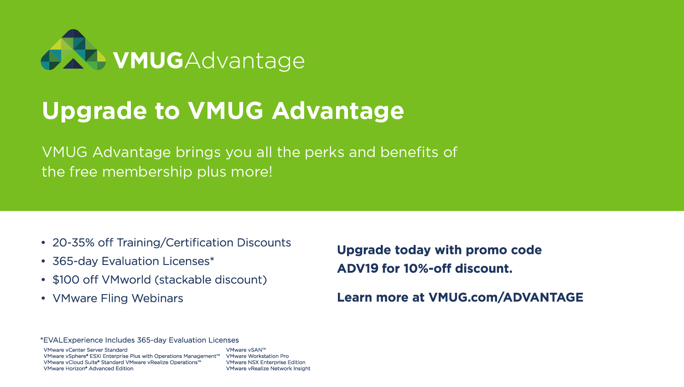
VMUG Advantage – A good way to start

Slide 17
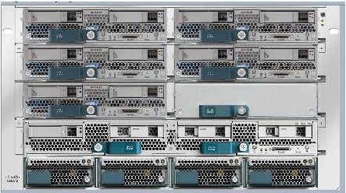
vSphere upgrade 6.0u2 to 6.5u1e & VCSA
Prod & DR environment
Recently built dev
What made me upgrade?

Slide 18
vSphere upgrade from 6.0u2 to 6.5u1e VCSA
Open a case with VMware – Pro Active
Health check
HCL & software (Horizon, Veeam, etc)
Ready to migrate to the VCSA?
Get ready for the HTML5 and Java. C# gone in 6.5

Slide 19
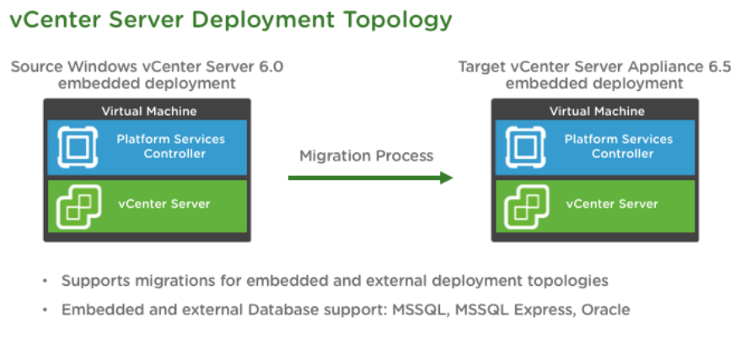

Slide 20
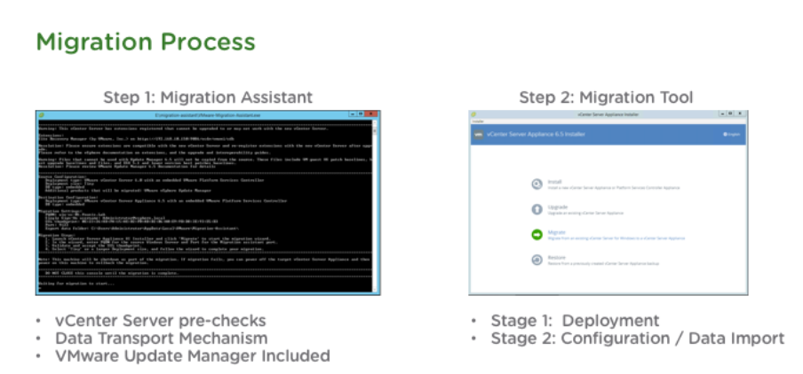

Slide 21
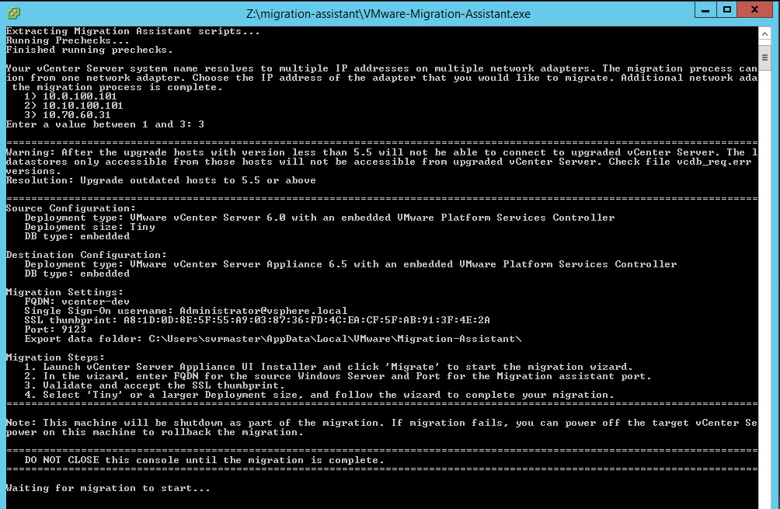
vSphere upgrade to 6.5

Slide 22
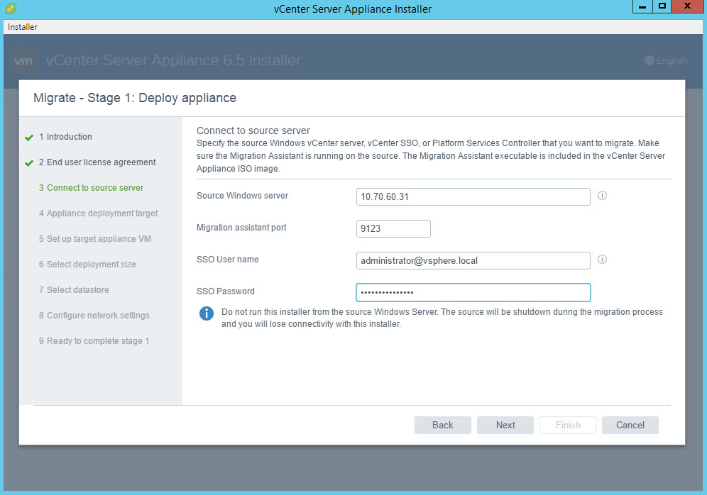

Slide 23
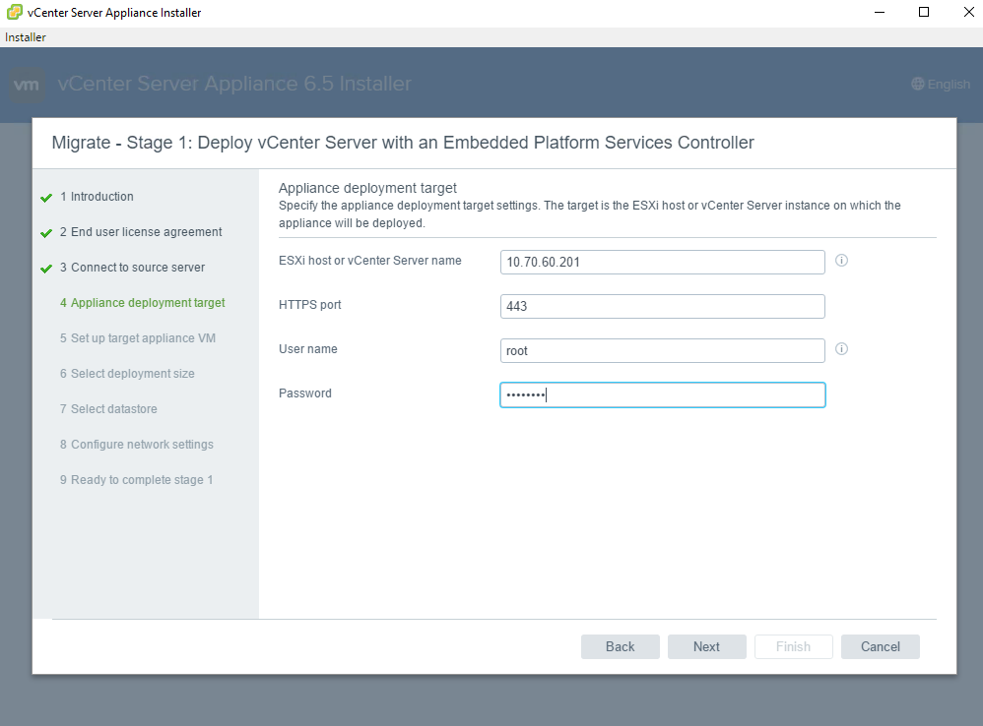

Slide 24
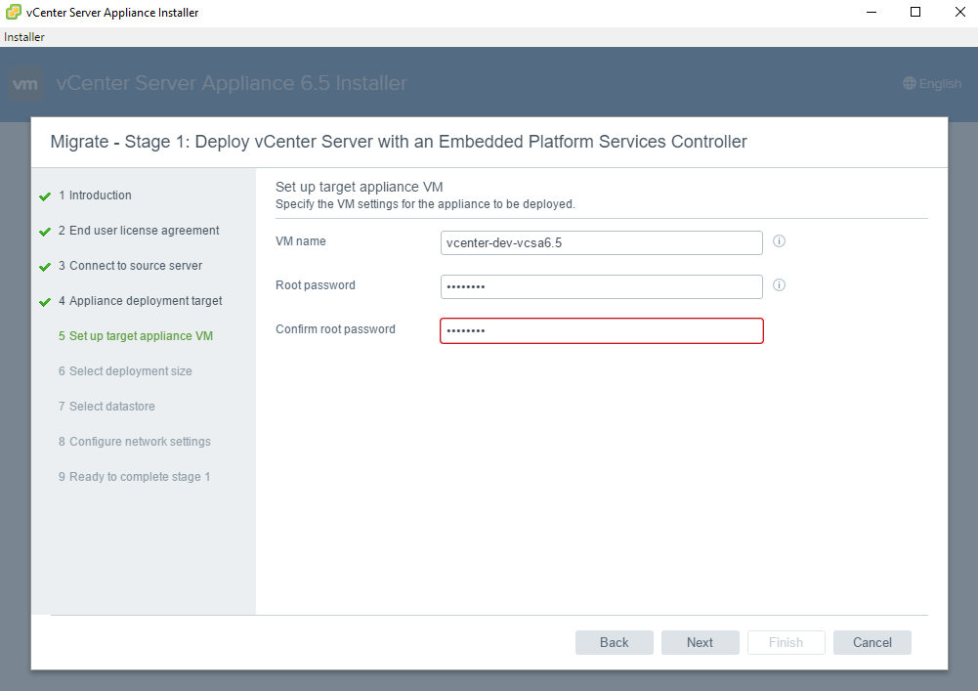

Slide 25
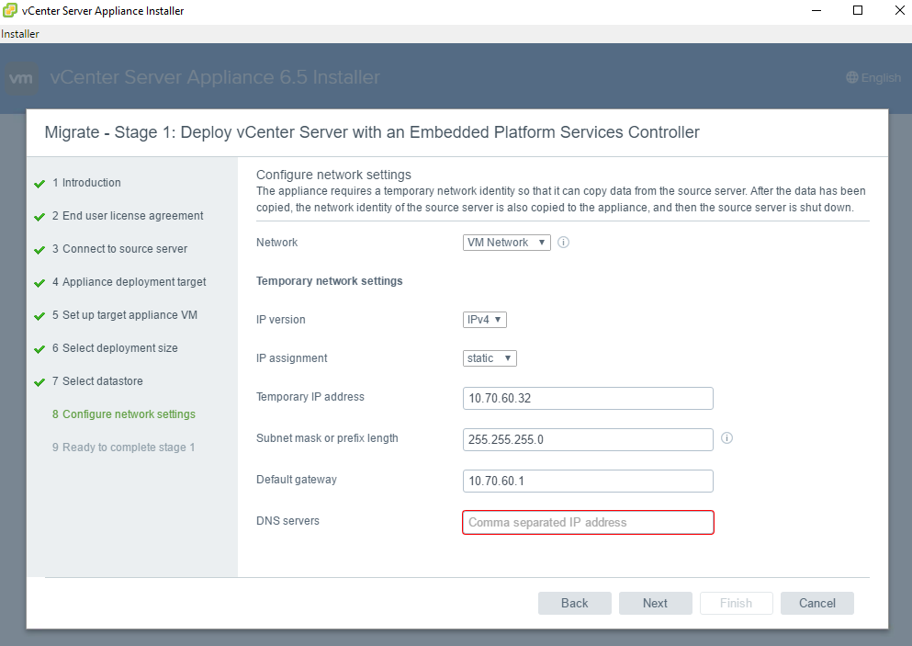

Slide 26
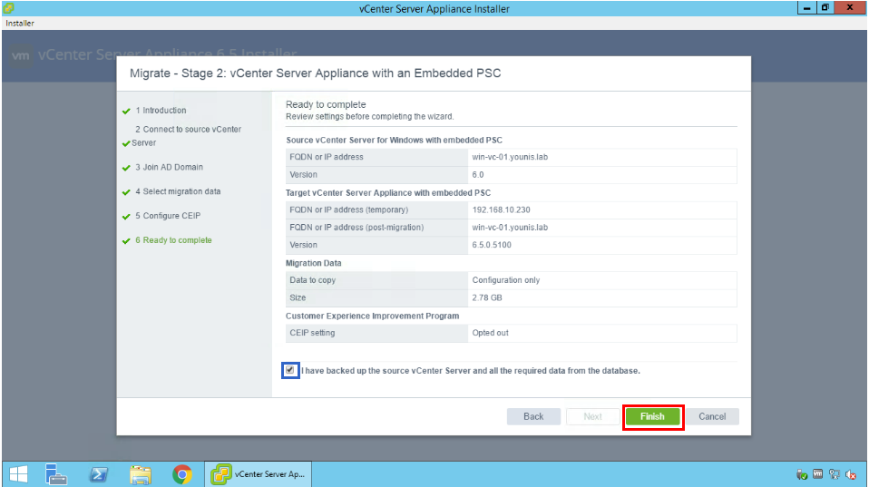

Slide 27
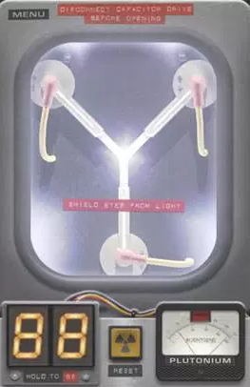
Recap of the upgrade/migration – This is how it happens

Slide 28
Recap of the 6.0 – 6.5 upgrade/migration to VCSA
Attach ISO to VCenter server and run Migration-Assistant
Auto runs pre checks and will ask which NIC to replace if there are multiple
Run UI Installer from a separate VM that can route to current VCenter server. Choose deployment size, Datastore, network settings w/ temp IP for VCSA. Complete Stage 1
Stage2 – connects to source server, pre migration checks, join AD, select data to migrate (config, events, tasks, perf metrics)
Finish – Source VCenter will be shutdown

Slide 29
Lessons Learned
Check HCL/Know your environment
VMware Product Interoperability Matrix
Remove unwanted VIBs
Esxcli –server=servername software vib remove –vibname=name
Read release notes
https://docs.vmware.com/en/VMware-vSphere/6.5/rn/vsphere-esxi-vcenter-server-65-release-notes.html

Slide 30
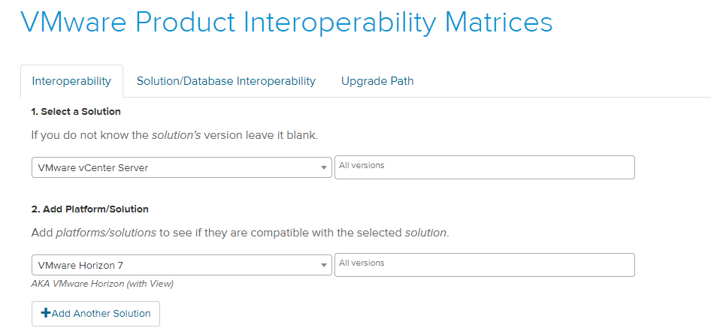

Slide 31
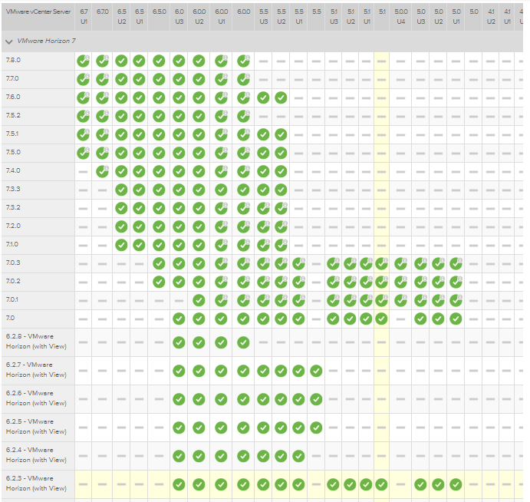

Slide 32
Documentation
Make your job easier
Checking driver/firmware versions across the environment
Software/application versions
Last time upgraded

Slide 33
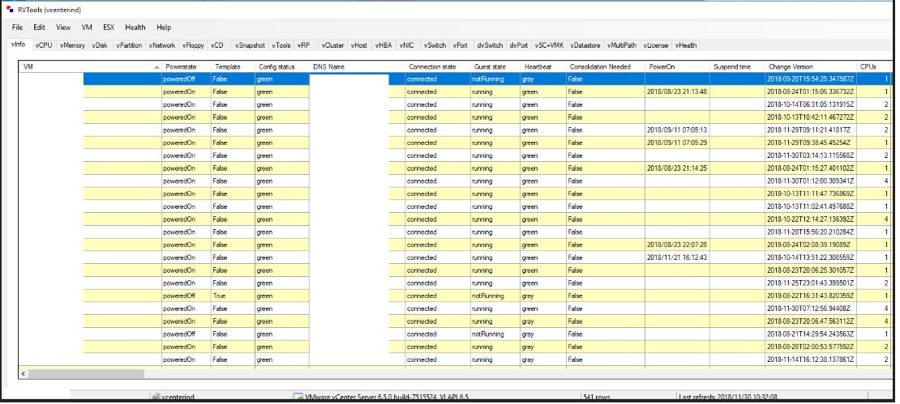
A couple helpful tips for gathering info from your environment.
RVTools, a very complete .Net application to gather data, identify and fix issues (Rob de Veij)

Slide 34
Tips and Recommendations
Data Protection
Use Update Manager
Security updates
Keep your infrastructure up to date… or close
Don’ have to be cutting edge, that’s for the lab
Complete the upgrade (VMware Tools, VM Compatibility, VMFS, TLS)
Consecutive days of uptime is not good
This means you’re not patching

Slide 35
Podcasts
Virtually Speaking
Top 10 VMware Tools
VMware Communities Roundtable
Packet Pushers - Datanauts

Slide 36


Join VMware Code & VMTN
https://code.vmware.com/web/code/join
There is a #vDocumentation channel in there ☺
Access to bloggers and admins who have shared their scripts
Spirit of sharing and building from each other
@alanrenouf, @lamw, @vBrianGraf, @kmruddy

Slide 37
Some extra links
https://vexpert.vmware.com
https://communities.vmware.com/community/vmtn/content
https://code.vmware.com/web/code/join
https://featurewalkthrough.vmware.com/t/vsphere-6-5/vcenter-server-6-0-embedded-migration-to-appliance/
http://masteringvmware.com/how-to-migrate-vcenter-server-6-to-vcsa-6-5-step-by-step/

Slide 38
Some extra links
https://vexpert.vmware.com
https://communities.vmware.com/community/vmtn/content
https://code.vmware.com/web/code/join
https://featurewalkthrough.vmware.com/t/vsphere-6-5/vcenter-server-6-0-embedded-migration-to-appliance/
http://masteringvmware.com/how-to-migrate-vcenter-server-6-to-vcsa-6-5-step-by-step/

Slide 39


Slide 40
The END.
Thanks to the following…
@myvmug
@arielsanchezmor
@vexpert
#vCommunity
@DenverVMUG
Questions?

